Slide 1

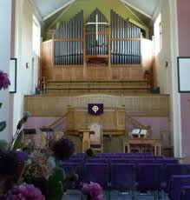
Welcome to church
We seek to bring people to Jesus, and together grow in our relationship with God and each other as we serve the community
WORSHIP God GROW Together SERVE Others

Slide 2

We are so glad you joined us today.
Please sign our visitors book in the foyer and take our greetings to your home church.
WORSHIP God GROW Together SERVE Others

Slide 3

An induction loop system is provided
Please switch your hearing aid to the ‘T’ position for reception
WORSHIP God GROW Together SERVE Others

Slide 4
Thank you for joining us today. If you would like to contact us or receive a visit please email office@cpbc.co.uk
Or send a message via our website www.cpbc.co.uk
WORSHIP God GROW Together SERVE Others

Slide 5


Welcome to Clarence Park Baptist Church
This service will be live-streamed
If you do not consent to being filmed,
then please ensure that you are sitting
in the back 2 rows or in the balcony.
(This will ensure you are outside of the filming zone)
Please speak to one of the Safeguarding team
if you are unsure of what to do or require further information
WORSHIP God GROW Together SERVE Others

Slide 6




CLARENCE PARK BAPTIST CHURCH
4 Ways you can give financially
to the ministry and work of our church.
ON-LINE BANKING | REGULAR GIVING | CASH | POST
Sort Code 40-52-40 Account Number 00035721 | Please pick up a standing order form or email office@cpbc.co.uk | Please use the trays/ bags when the offering is taken during the service. | By CHEQUE Payable to: ‘Clarence Park Baptist Church’ To Clarence Park Baptist Church, Walliscote Road, Weston-super-Mare, North Somerset BS23 1ED

Slide 7




c
 | Like our Facebook Page Clarence Park Baptist Church
 | Request to join our Facebook Group Clarence Park Baptist Church
 | Visit our website www.cpbc.co.uk
 | Watch online ClarenceparkTV
o
n
n
e
c
t

Slide 8
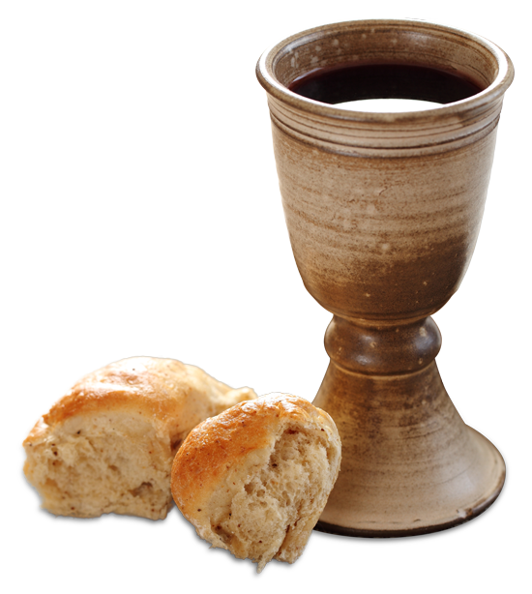
COMMUNION
Please note that On Sundays
we serve Non-Alcoholic Wine and Gluten Free Bread

Slide 9
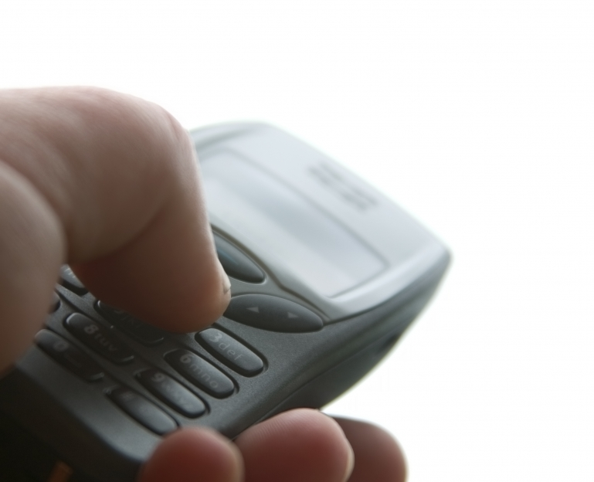
Please would you ensure that your mobile phone is switched
OFF
during the service
Thank you.

Slide 10
Caprione Choir
Practice Dates
Every Tuesday
during term-time
At 7.30pm in the Rear Hall
If you would like to join the group then please speak to Kaye Cooke
or telephone 01934 625788

Slide 11


“THE CLANGERS”
Clarence Park Baptist Church Handchimes group
Practice Dates
2nd and 4th
Thursdays of the month
At 7.30pm in the Primary room
(use the North Entrance)
If you would like to join the group then please speak to Jane Ridge

Slide 12



Tots and Toddlers
Our Tots and Toddler group meets on a Thursday
morning during term time from 10 - 11:30am.
We cater for children from 0-4 years
Parents, grandparents and child minders
  are all welcome to come to our meetings.
  A small charge is made which
  Includes a drink and biscuits
  for both children and adults.

Slide 13


Slide 14


Slide 15

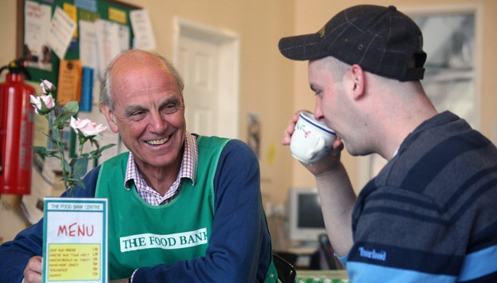
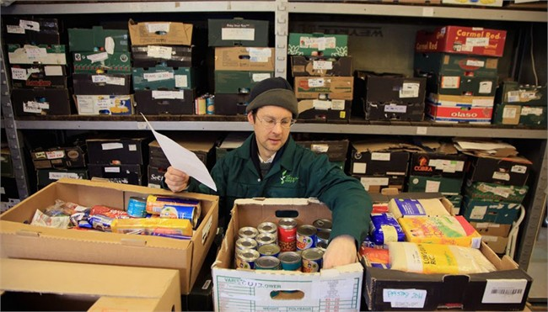
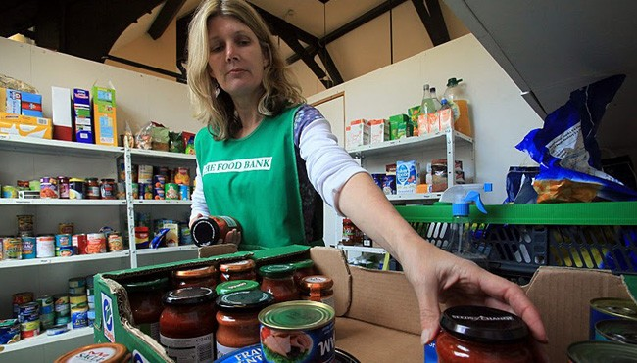
Can you help
Weston foodbank
By providing the following items
UHT and Powdered milk
Cereals
Sugar
Pasta sauces
Tinned Vegetables
Tinned tomatoes
Donations can be made via the box in the church foyer
Foodbank is a registered charity in England And Wales.
Charity Number 1110522 - Reg. Ltd.
Co. Number: 5434524 - Reg. in England & Wales

Slide 16

Renew 193 is hosted by
Clarence Park Baptist Church,
Milton Baptist Church
and Worle Baptist Church
193 High St, Worle,
Weston-Super-Mare BS22 6JS
For more information
email: renew193worle@gmail.com
www.renewwellbeing.org.uk
    Monday 10am-12noon
    Tuesday 10am-12noon & 2pm-4pm
    Wednesday 10am-12noon & 2pm-4pm
    Thursday 2pm-4pm
(Closed on Bank Holidays)
Are you feeling low? Anxious? Lonely? Isolated?
Do you want to improve your wellbeing and mental health?
Come along, slow down or bring and share a hobby if you wish.
Craft resources/activities are available and free.
You are welcome to relax and enjoy peace in our quiet/ prayer space.
Pop in or come along for the whole 2 hours.
Always a kind welcome, a good cuppa and someone to listen.

Slide 17
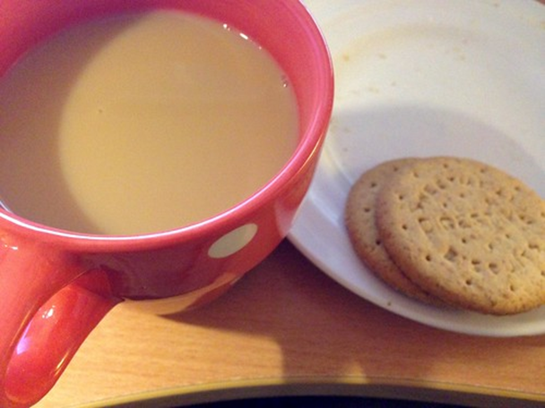
Community
Coffee Morning
Thursdays 9.30-11.30am
Free drinks served ‘til 11.30
All welcome…

Slide 18
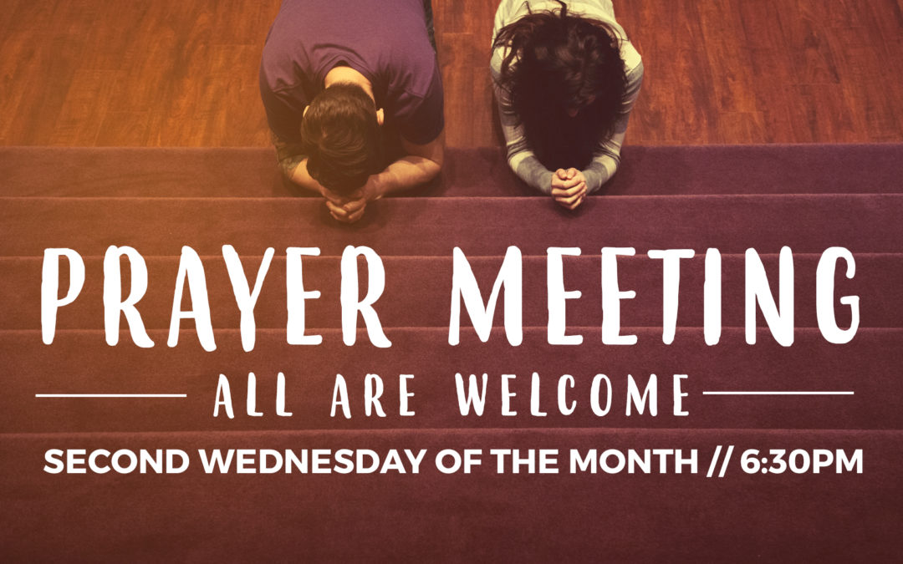
Join With Others In the sanctuary
7:30 - 8:30 pm 3rd Thursday of the Month
Praying For The Church, Our Community, Our Nation, The World And For One Another

Slide 19

Join with others for
Topical Bible Discission, Fellowship and Prayer
Meeting in the church 10.30 am to 12:00 noon
2nd and 4th Wednesday of the month
For further information speak to Keith or Judith Newport

Slide 20


BMS Birthday
Scheme
We are thankful for to all those who have given to the BMS Birthday scheme in the past.
If you would like to join us in raising funds for BMS in this way please speak to Julie Dawkins or email Julie.Dawkins@cpbc.co.uk

Slide 21

Looking to connect with others and together learn to walk closer with Jesus?
Join our small group meeting monthly at 7.30pm,
Location - ‘Windyridge, 37 Cecil Road.
For more information speak to John Dawkins or Kaye Cooke

Slide 22

Communion Offering:
Sept: Operation Agri
Oct: Agape Fund
Nov: Christians Against Poverty
Dec: Agape Fund
January Somewhere To Go
Feb Agape
Mar Home for Good
Apr Agape Fund
May Weston Street Pastors
June Agape Fund
July Weston Food Bank
August Agape Fund
September Operation Agri Harvest Appeal
October Agape Fund.
November Christians Against Poverty
December Agape Fund

Slide 23

Sept 1st _ Bring your own lunch at 12.30pm
Sept 15th Harvest with auction
Oct 6th Card Bingo
Oct 20 To be arranged!
Nov 3rd Baptist Women’s World Day of Prayer – Jane Ridge
Nov 17th Hearing Dogs – Graham Dyane
Dec 1st – Busman’s Holiday – John Dawkins
Dec 15th Christmas Flowers – Pat Porter
UPCOMING EVENTS
1st Sept – Bring-your-own-Lunch
And time of fellowship in the rear hall at 12.30pm

Slide 24

Chelmsley Wood Baptist Church are visiting CPBC!
Sunday 7th Sept 10.30am
Join us for a
Bring and Share Lunch after the service!
Please use sign up sheet !

Slide 25
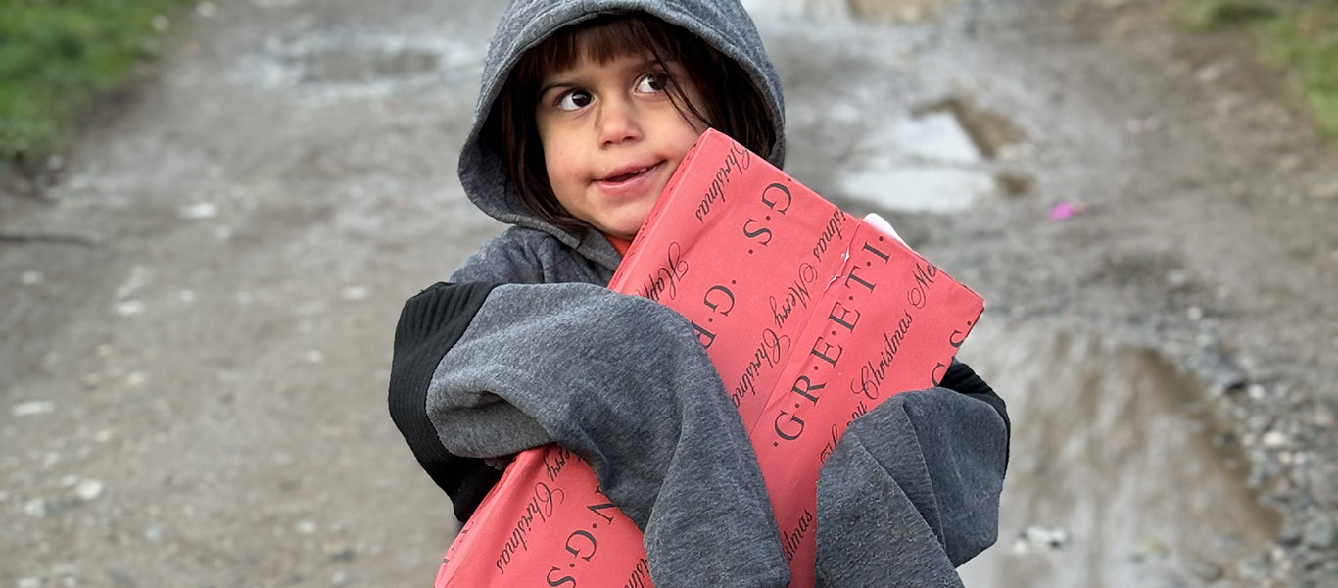
Blytheswood Shoebox Appeal
If you feel able to donate things to put into boxes, empty or filled boxes or wish to donate to the costs of delivery please speak to Rosie Pike or Mandi Hawkins.
Completed boxes need to be ready towards the end of October

Slide 26


Prayer Breakfast
Please join with us for Prayer and Breakfast on
Saturday 20th September
9am – 10.30am
at Clarence Park Baptist Church
(Gluten free and vegan alternatives available)

Slide 27
Don’t forget to pick up your notice sheet in the foyer,
which lists activities taking place
or find a copy
on the church website.
If you are holding activities which you want included in the notice sheet please speak to Julie Dawkins
WORSHIP God GROW Together SERVE Others

Slide 28

Why not join us for a cup of tea
or coffee after the service?
WORSHIP God GROW Together SERVE Others

